Slide 1

Tensorflow tutorial
Yoon-gu Hwang
Yonsei University

Slide 2

Tensorflow?
TensorFlow was originally developed by the Google Brain team for Google's research and production purposes
TensorFlow is Google Brain's second generation machine learning syste
Under the Apache 2.0 open source license on November 9, 2015

Slide 3
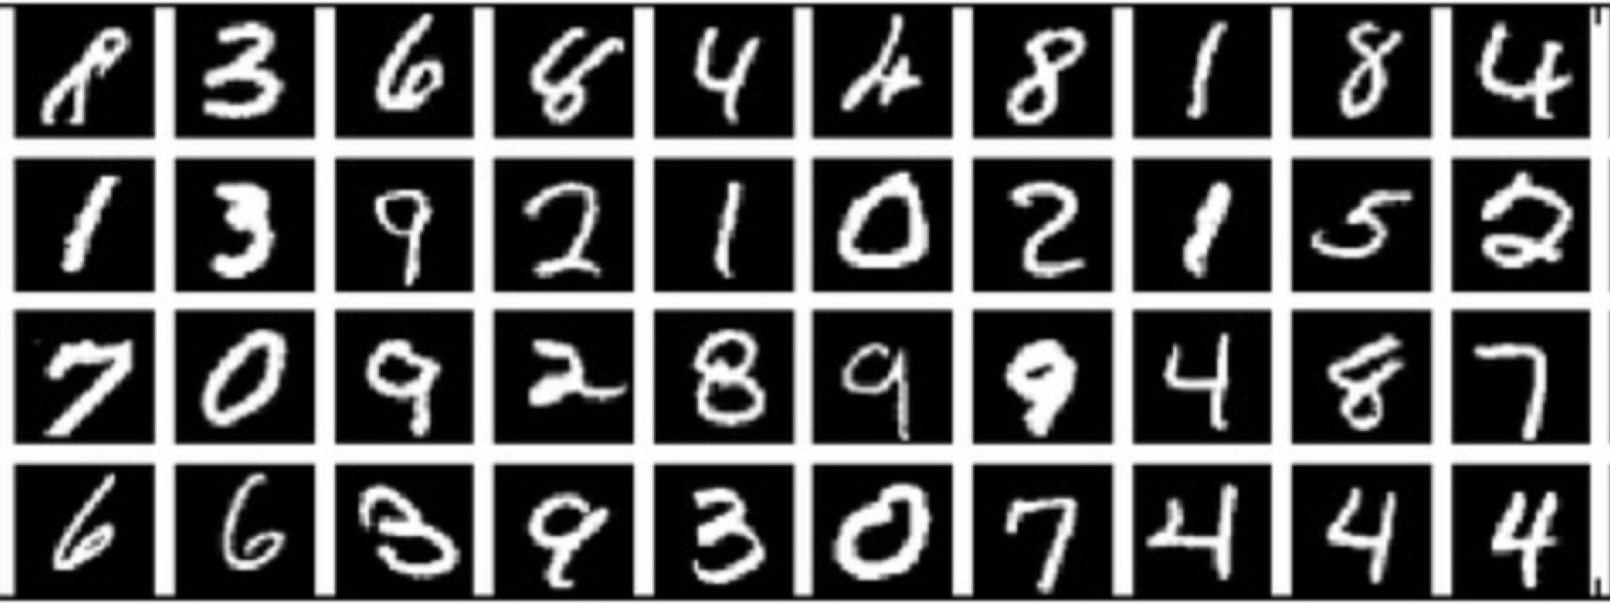
Mnist dataset

Slide 4
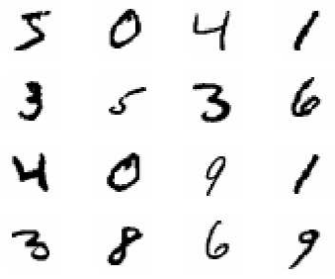
MNIST?
Mixed National Institute of Standards and Technology database
Handwritten Digits
55,000 training images
10,000 test images
28 x 28 images
28
28

Slide 5

Installation
Windows 10

Slide 6
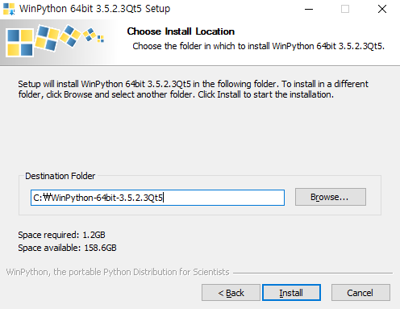

Slide 7
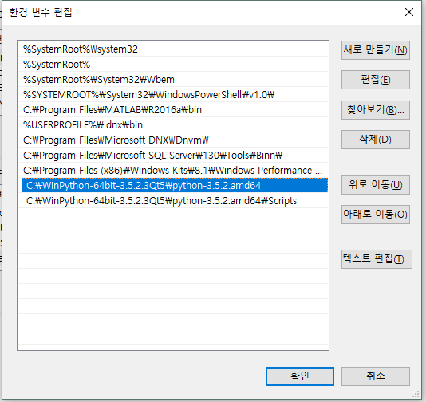

Slide 8
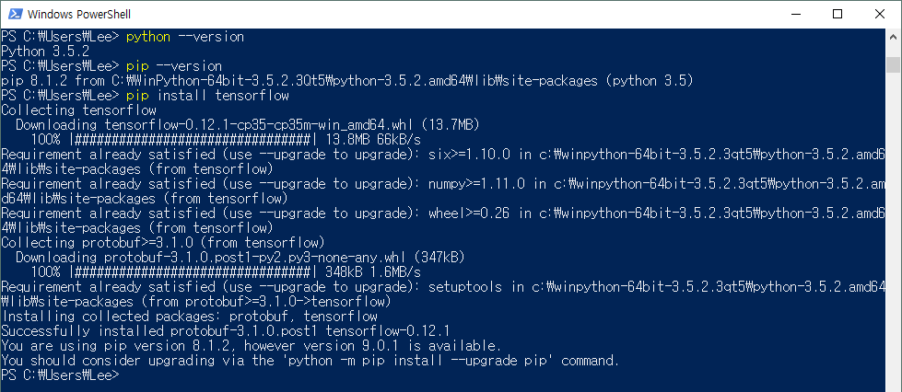
After Reboot

Slide 9
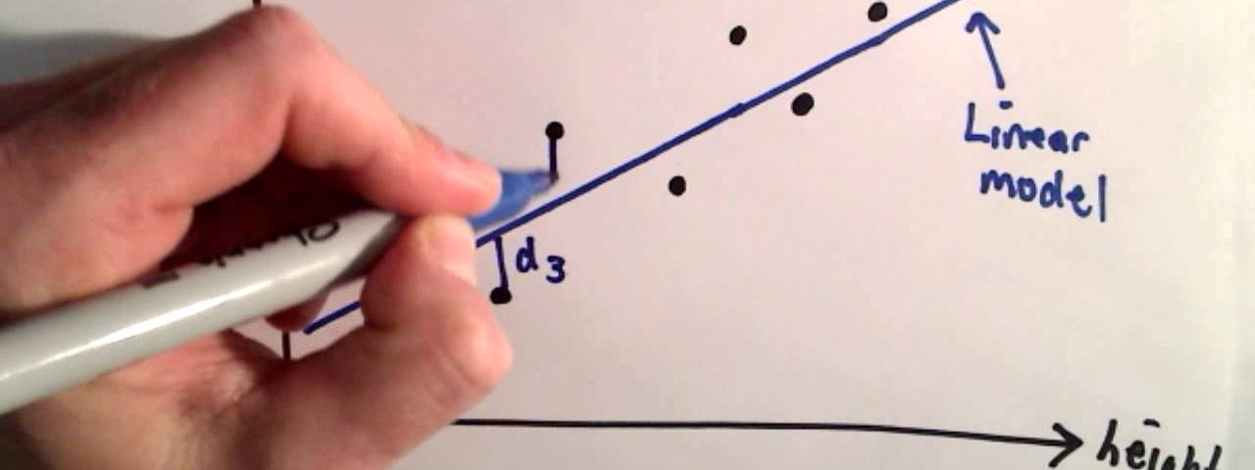
Linear regression

Slide 10
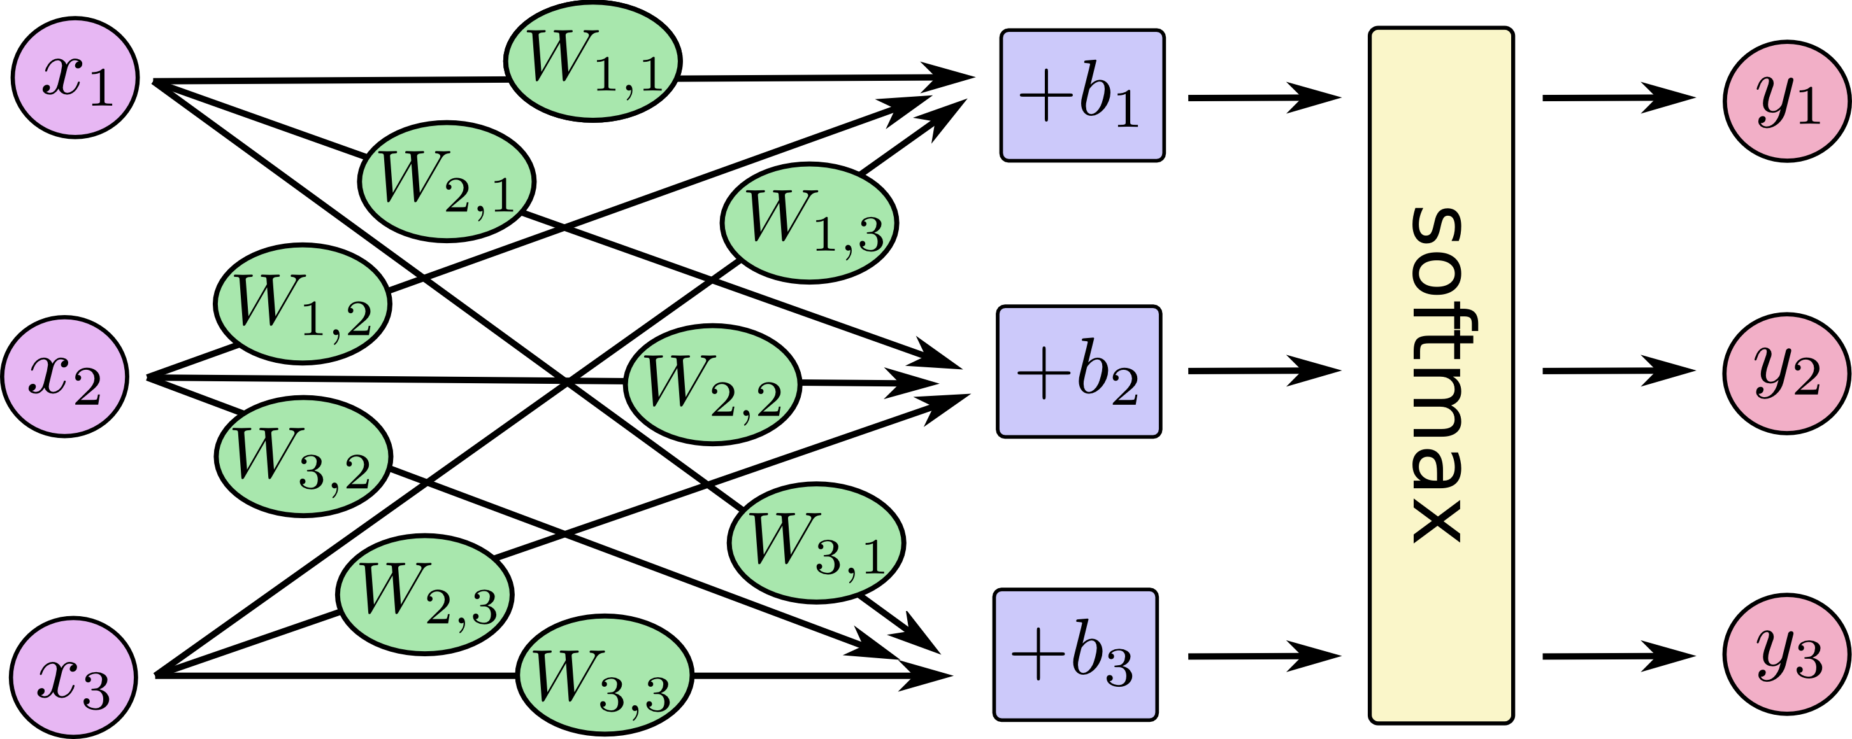

Slide 11
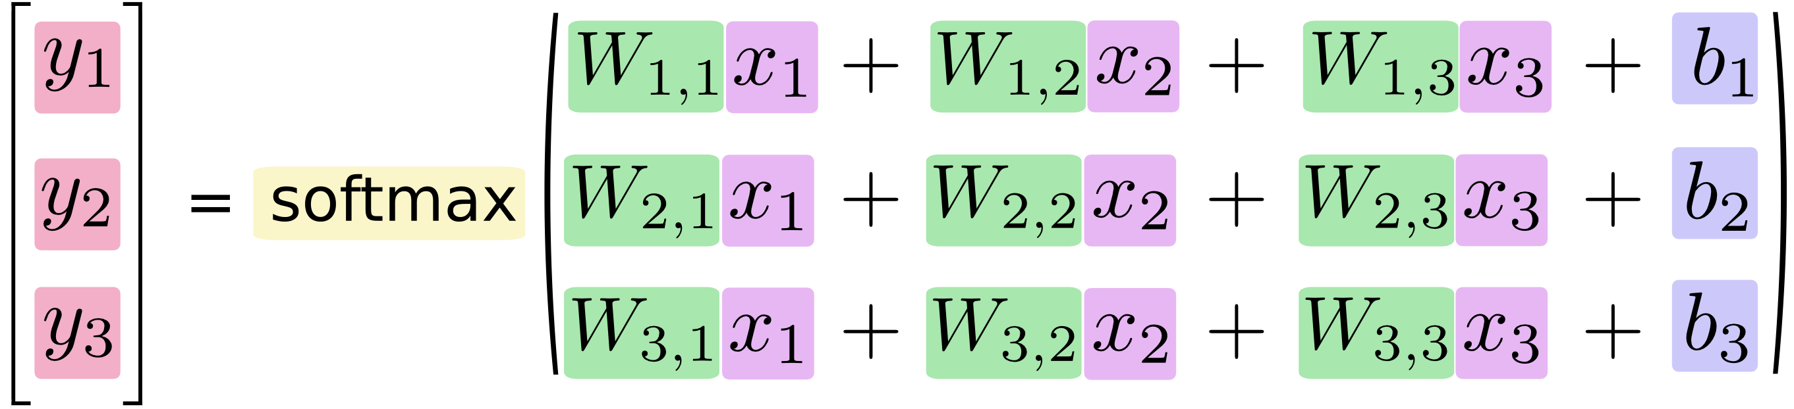

Slide 12
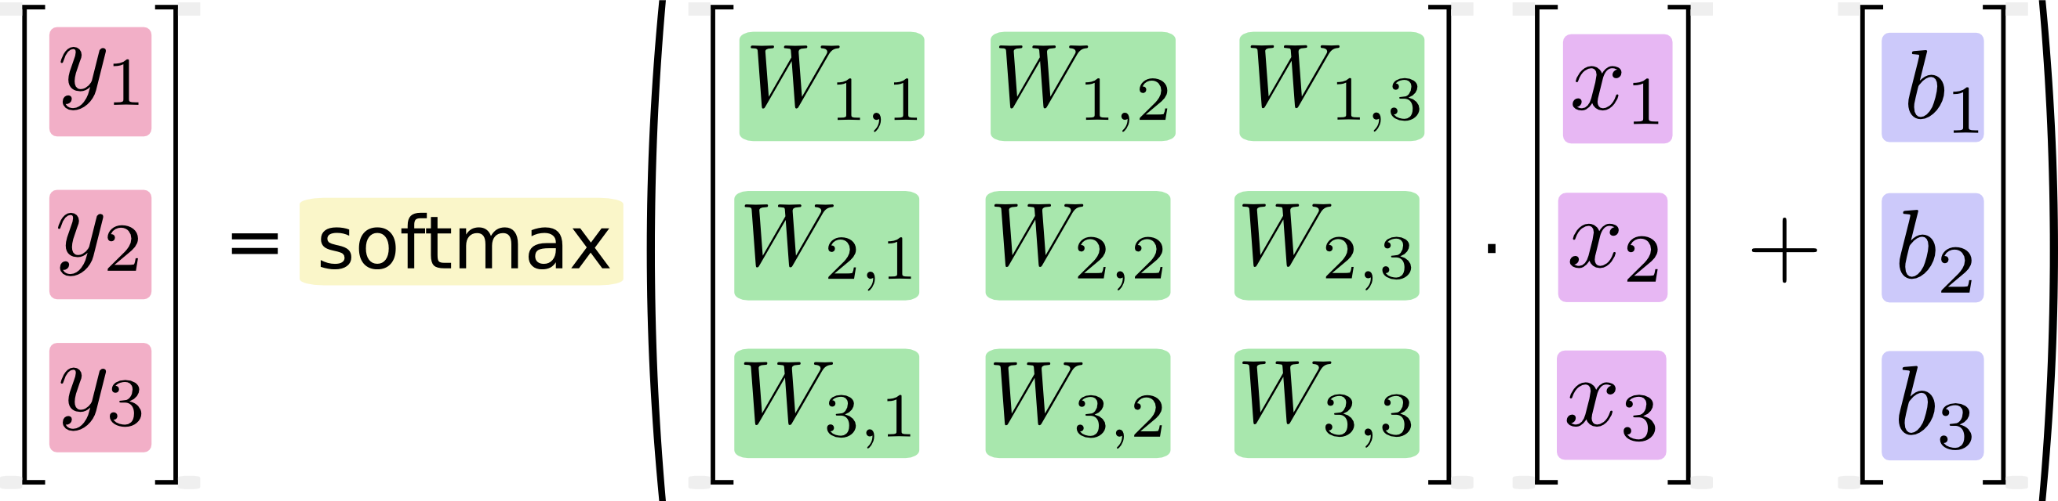

Slide 13
Variable types
x = tf.placeholder(…)
W = tf.Variable(…)
b = tf.Variable(…)
y = tf.nn.softmax(tf.matmul(x, W) + b)

Slide 14
Linear regression
Demo
https://github.com/yoon-gu/tensorflow-tutorial

Slide 15
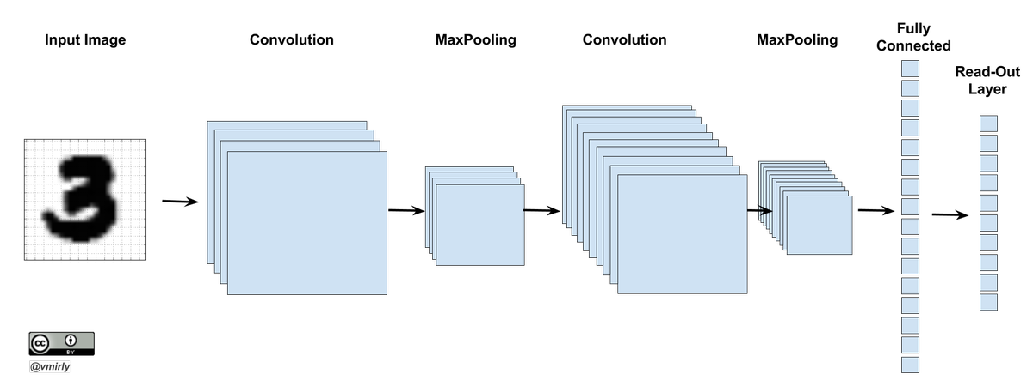
Convolutionary neural network

Slide 16
Before deep learning
Collect data
Feature Design
Feature Extraction
Machine Learning
We have to DESIGN filters to get features!

Slide 17
Feature extractions by Convolution
0 | 1 | 1 | 2 | 2 | 2 | 1 | 1 | 0
1 | 2 | 4 | 5 | 5 | 5 | 4 | 2 | 1
1 | 2 | 4 | 5 | 5 | 5 | 4 | 2 | 1
2 | 5 | 3 | 12 | 24 | 12 | 3 | 5 | 2
2 | 5 | 0 | 24 | 40 | 24 | 0 | 5 | 2
2 | 5 | 3 | 12 | 24 | 12 | 3 | 5 | 2
1 | 2 | 4 | 5 | 5 | 5 | 4 | 2 | 1
1 | 2 | 4 | 5 | 5 | 5 | 4 | 2 | 1
0 | 1 | 1 | 2 | 2 | 2 | 1 | 1 | 0
4 | 3 | 2 | 1 | 0 | -1 | -2 | -3 | -4
5 | 4 | 3 | 2 | 0 | -2 | -3 | -4 | -5
6 | 5 | 4 | 3 | 0 | -3 | -4 | -5 | -6
7 | 6 | 5 | 4 | 0 | -4 | -5 | -6 | -7
8 | 7 | 6 | 5 | 0 | -5 | -6 | -7 | -8
7 | 6 | 5 | 4 | 0 | -4 | -5 | -6 | -7
6 | 5 | 4 | 3 | 0 | -3 | -4 | -5 | -6
5 | 4 | 3 | 2 | 0 | -2 | -3 | -4 | -5
4 | 3 | 2 | 1 | 0 | -1 | -2 | -3 | -4
0 | 1 | 1 | 2 | 2 | 2 | 1 | 1 | 0
1 | 2 | 4 | 5 | 5 | 5 | 4 | 2 | 1
1 | 2 | 4 | 5 | 5 | 5 | 4 | 2 | 1
2 | 5 | 3 | -12 | -24 | -12 | 3 | 5 | 2
2 | 5 | 0 | -24 | -40 | -24 | 0 | 5 | 2
2 | 5 | 3 | -12 | -24 | -12 | 3 | 5 | 2
1 | 2 | 4 | 5 | 5 | 5 | 4 | 2 | 1
1 | 2 | 4 | 5 | 5 | 5 | 4 | 2 | 1
0 | 1 | 1 | 2 | 2 | 2 | 1 | 1 | 0
9
9
9
9

Slide 18
Example 1
Moving Average
Sobel
Laplacian

Slide 19
Example 2
Moving Average
Sobel
Laplacian

Slide 20
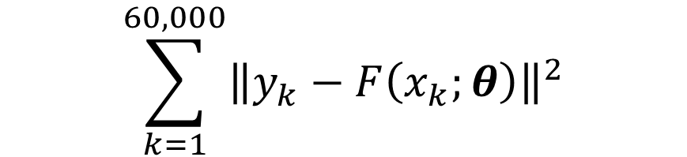
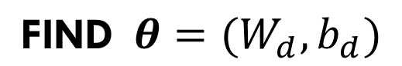
Optimization Problem 1
$$\text{FIND} θ=(W_{d},b_{d})$$
$$\sum_{k=1}^{60,000}{{\left\|y_{k}−F\left(x_{k};θ\right)\right\|}^{2}}$$
that MINIMIZE

Slide 21
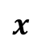

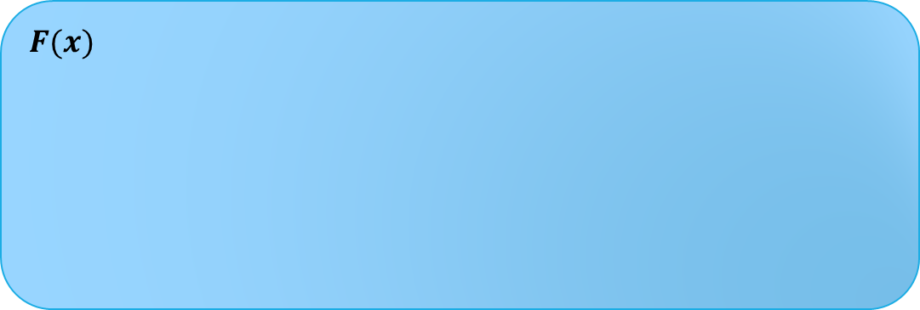
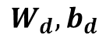

Flow
For given $W_{d}$ and $b_{d},$
$$F(x)$$
28x28
Feature Extraction
(Convolution)
Sigmoid
Pooling
Softmax
Image
$$x$$
Prob
$$y$$
$$W_{d}, b_{d}$$
[20x20] x 9
[20x20] x 9
[10x10] x 9
10 x 1

Slide 22
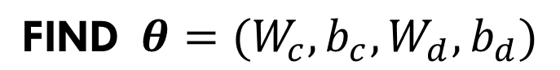
Optimization Problem 2
$$\text{FIND} θ={(W}_{c}, b_{c}, W_{d},b_{d})$$
$$\sum_{k=1}^{60,000}{{\left\|y_{k}−F\left(x_{k};θ\right)\right\|}^{2}}$$
that MINIMIZE

Slide 23

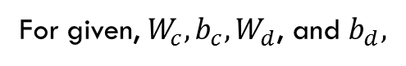
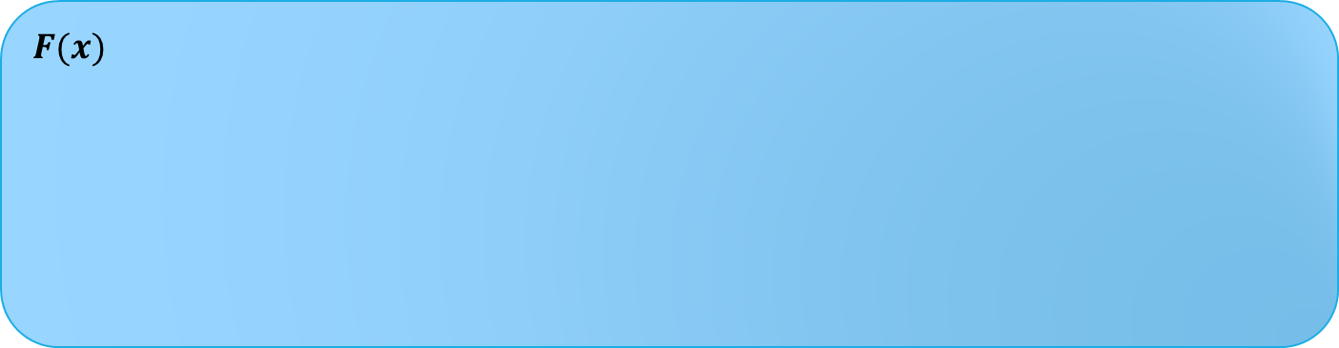
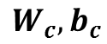
Flow
For given, $W_{c}, b_{c}, W_{d}$, and $b_{d},$
$$F(x)$$
28x28
Convolution
Sigmoid
Pooling
Softmax
Image
$$x$$
Prob
$$y$$
$$W_{c}, b_{c}$$
$$W_{d}, b_{d}$$
[20x20] x 9
[20x20] x 9
[10x10] x 9
10 x 1

Slide 24
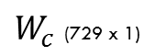
Parameter visualization
$W_{c}$ (729 x 1)
1st
9x9=81
9x9=81
2nd
9x9=81
8th
…
3rd
9th
9x9=81
9x9=81

Slide 25
CNN Demo
https://github.com/yoon-gu/tensorflow-tutorial

Slide 26
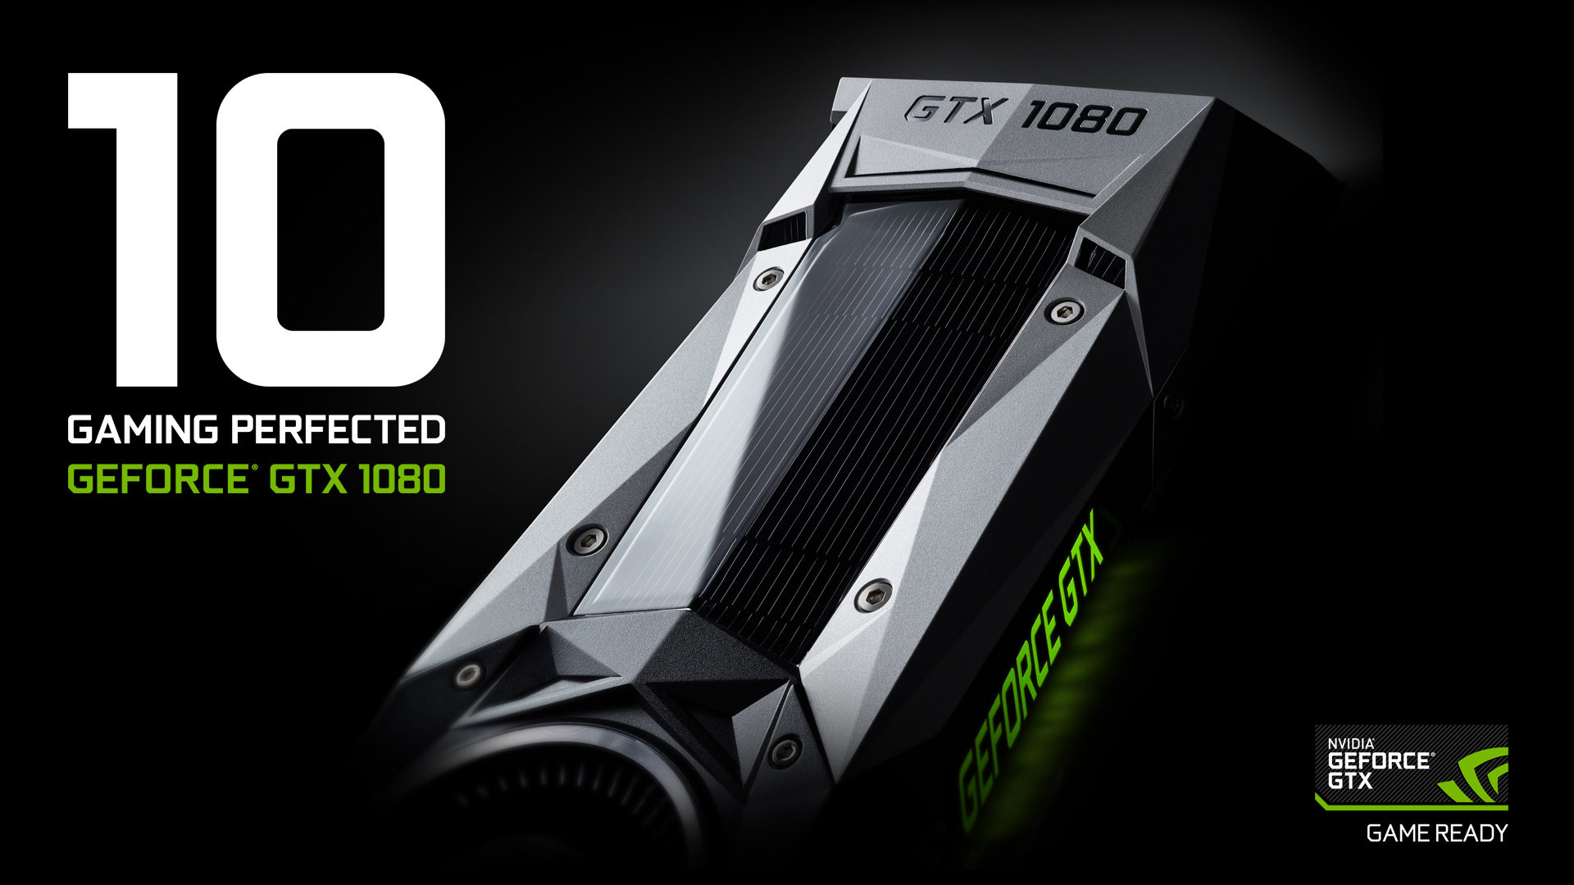
GPU Acceleration

Slide 27
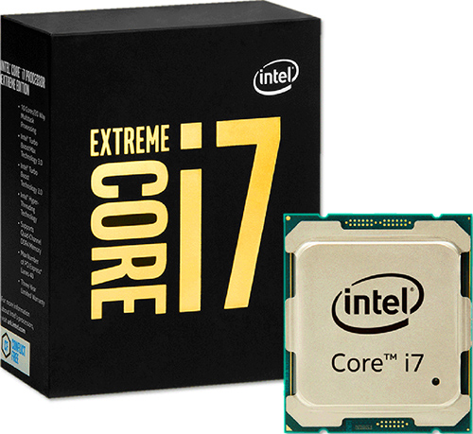
Performance
23 minutes VS 2 minutes
Intel® Core™ i7-6900K @ 3.20GHz
NVIDIA Geforce GTX 1080

Slide 28

Question?

